Slide 1
SB 850: Homeless Emergency Aid Program (HEAP)

Slide 2
Agenda
SB 850 Overview
HCFC Team Members
HEAP Grant Overview
Eligible Applicants
Available Funding
Application Process
Distribution of Funds
Expenditure Deadlines
Application Timeline
Program Timeline
Eligibility Criteria
Shelter Crisis Declaration
Eligible Uses of HEAP Funds
Homeless Youth Set Aside
Ineligible Uses of HEAP Funds
Technical Assistance
Contact Information
Questions
https://www.bcsh.ca.gov/hcfc/

Slide 3
SB 850 Overview
Moves the Homeless Coordinating and Financing Council (HCFC) from Department of Housing and Community Development (HCD) to the Business, Consumer Services and Housing Agency (BCSH).
Designates the Secretary of BCSH as Chair of the HCFC.
Adds representative to the HCFC from the Department of Transportation and a formerly homeless youth who lives in California.
Provides permanent staff under BCSH to support HCFC mandates
Establishes the Homeless Emergency Aid Program (HEAP) for purposes of providing localities with one-time flexible block grant funds to address their immediate homelessness challenges.
https://www.bcsh.ca.gov/hcfc/

Slide 4
HCFC Team Members
Position | Staff
Executive Officer | Ginny Puddefoot
Research and Policy Specialist | Kelly Joy
Council Specialist | Natalie Nguyen
HEAP Grant Manager | Daniel Castillo
Local Government Liaison | Lahela Mattox
Data Systems Development Project Manager | TBD
https://www.bcsh.ca.gov/hcfc/

Slide 5
HEAP Grant Overview
HEAP is a $500 million block grant program designed to provide direct assistance to cities, counties and Continuums of Care to address the homelessness crisis throughout California.
Designed to provide immediate, one-time, flexible funding.
Provides support until additional resources are available (i.e. SB 2, No Place Like Home, SB 3).
https://www.bcsh.ca.gov/hcfc/

Slide 6
Eligible Applicants
Applications to the HEAP program will only be submitted by the 11 large cities and the 43 CoCs identified in the HEAP Program Guidance-Attachment B.
Individual persons, cities (not identified as one of the 11 large cities), counties, and/or nonprofit organizations are not eligible to apply directly to HCFC for HEAP funds. Those interested in receiving HEAP funds will apply directly to their local CoC.
https://www.bcsh.ca.gov/hcfc/

Slide 7
Available Funding
HEAP funding is divided into 3 categories of distribution.
Category for Distribution | Funded Amount | Eligible Applicants
(a) CoC -Based on Point in Time Count Ranges | $250M | CoC
(b) CoC -Based on Percentage of Homeless Population | $100M | CoC
City / City that is also a County – Based on general population | $150M | Large cities with a population over 330,000
Although there are two categories of funds for the CoCs, only one application will be submitted for the total amount of the CoCs allocation.
Only one application will be submitted by each large city for the total amount allocated.
https://www.bcsh.ca.gov/hcfc/

Slide 8
Available Funding (continued)
Continuum of Care 50213 (a) and 50213 (b)
https://www.bcsh.ca.gov/hcfc/

Slide 9
Available Funding (continued)
https://www.bcsh.ca.gov/hcfc/

Slide 10
Available Funding (continued)
HEAP Large Cities Allocation
CoC Number | Jurisdiction | 50213(c) Large Cities $150,000,000 Allocation | 50214(c) Minimum Youth Set Aside Per Large City Allocation
CA-600 | Los Angeles | 85,013,607.00 | 4,250,680.35
CA-601 | San Diego | 14,110397.95 | 705,519.90
CA-500 | San Jose | 11,389,987.16 | 569,499.36
CA-501 | San Francisco | 10,564,313.22 | 528,215.66
CA-502 | Oakland | 8,671,116.82 | 433,555.84
CA-602 | Santa Ana | 3,690,885.841 | 184,544.29
CA-602 | Anaheim | 3,690,885.841 | 184,544.29
CA-503 | Sacramento | 5,645,699.61 | 282,284.98
CA-514 | Fresno | 3,105,519.90 | 155,276.00
CA-606 | Long Beach | 2,869,833.12 | 143,491.66
CA-604 | Bakersfield | 1,247,753.53 | 62,387.68
https://www.bcsh.ca.gov/hcfc/

Slide 11
Available Funding (continued)
The HEAP team encourages all CoCs and large cities to submit applications during Round 1.
Round 1 application period is September 5, 2018-December 31, 2018
Funds not applied for in Round 1 will be redistributed among the CoCs and large cities in Round 2.
Allocations will be reduced to a proportional share of the HEAP funds remaining after Round 1
The same formula distribution methodology used in Round 1 will determine the allocations in Round 2
https://www.bcsh.ca.gov/hcfc/

Slide 12
Application Process
There are two separate applications.
One for CoCs and another one for the 11 large cities
Streamlined process designed to quickly and efficiently award and distribute funds.
Applications will be reviewed and processed as they are received.
Application Map:
The application map and instructions were released August 17, 2018
The application map is a tool designed to assist HEAP applicant entities collect the information necessary to complete the application
https://www.bcsh.ca.gov/hcfc/

Slide 13
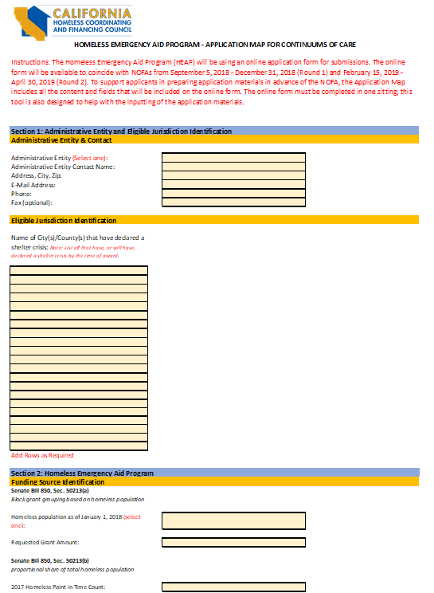
Application Map

Slide 14
Application Process (Continued)
Application Submission:
Online portal will open to coincide with NOFA rounds.
Application does not have a “save” feature and must be submitted in one sitting.
AEs are encouraged to use the Application Map to collect information in advance
Errors or missing information will flag for the applicant; must be corrected and completed before submission is complete.
The applicant will receive a confirmation email that includes a copy of the application, a tracking number, and a checklist of documents that must be submitted.
The applicant must reply to the email and attach all items listed on the checklist.
Documents must be submitted for the application to be considered complete
Application Review and Award:
HCFC Staff will review the applications as they are received.
Applicants are encouraged to submit applications early.
Award letters and the standard agreement will be issued simultaneously.
https://www.bcsh.ca.gov/hcfc/

Slide 15
Distribution of Funds
HCFC expects to disburse the HEAP funds within 60 days of the date the application is submitted and deemed complete.
A completed application includes the supporting documentation requested in the application
The approval process may extend beyond 60 days if the supporting documentation is incomplete and/or if there is a delay in the AE returning the signed standard agreement
100 percent of the allocation will be disbursed once the standard agreement is executed.
Funds will be issued directly to the administrative entity.
The CoC will establish a process to disburse funds to all eligible cities, counties, and nonprofit organizations
https://www.bcsh.ca.gov/hcfc/

Slide 16
Expenditure Deadlines
50 percent of the awarded funds must be contractually obligated by January 1, 2020.
100 percent of the funds must be expended by June 30, 2021.
Unexpended funds must be returned to BCSH.
https://www.bcsh.ca.gov/hcfc/

Slide 17
Application Timeline Round 1
The HEAP grant application process will be conducted through an online portal. Applications will be received immediately upon release of the Round 1 Notice of Funding Availability (NOFA) beginning on September 5, 2018.
Round 1
NOFA Release | Sep 5, 2018
Early Applications Received | Starting Sep 2018
Early Applications Awarded | Starting Sep 2018
Early Distribution of Funds Begins | Starting in late Oct 2018
Round 1 Application Cut-off Date | Dec 31, 2018
Standard Applications Awarded | Jan 2019
Standard Distribution of Funds Begins | March 2019
https://www.bcsh.ca.gov/hcfc/

Slide 18
Application Timeline Round 2
Funds not applied for in Round 1 will be available in Round 2.
Applications will be received immediately upon release of the Round 2 Notice of Funding Availability (NOFA) beginning on February 15, 2019.
Round 2
NOFA Release | Feb 15, 2019
Early Applications Received | Starting Feb 2019
Early Applications Awarded | Starting Feb 2019
Early Distribution of Funds Begins | Starting in late March 2019
Round 1 Application Cut-off Date | Apr 31, 2019
Standard Applications Awarded | May 2019
Standard Distribution of Funds Begins | July 2019
https://www.bcsh.ca.gov/hcfc/

Slide 19
Program Timeline
Information will be circulated to the listserv and posted to HCFC website. To subscribe to listserv: https://www.bcsh.ca.gov/hcfc/
Key Program Information and Documents | Scheduled Release Date
Program Guidance, Timeline, Sample Shelter Crisis Resolution, Funding Allocations | August 3, 2018
HEAP Frequently Asked Questions | August 10, 2018-Ongoing
Application Map | August 17, 2018
Application Instructions | August 17, 2018
Workshops / Webinars – Application Training Documents | August 13, 2018 – Ongoing
https://www.bcsh.ca.gov/hcfc/

Slide 20
Eligibility Criteria
CoCs and large cities must demonstrate that a local collaborative process has been conducted prior to application submission.
A collaborative process may include, but is not limited to,
Public meetings
Regional homeless taskforce meetings
Letters of support with signatures of endorsement
An adopted homeless plan
An adopted budget which includes HEAP funds
Proof of a public process may include, but is not limited to,
Sign-in sheets
Meeting minutes
Agendas
Public Comment logs
https://www.bcsh.ca.gov/hcfc/

Slide 21
Eligibility Criteria
A shelter declaration for each jurisdiction wanting to be a recipient of HEAP funds must be in place at the time of award.
CoCs with fewer than 1,000 homeless people, based on the 2017 HUD Point in Time count are exempt and can file a waiver with their application.
The county may declare a shelter crisis for the unincorporated areas of the county and is allowed to expend HEAP funding for county activities that serve all county residents.
Jurisdictions are not required to declare a shelter crisis. However, any jurisdiction that does not declare a shelter crisis is ineligible to be a direct recipient of HEAP funds.
https://www.bcsh.ca.gov/hcfc/

Slide 22
Shelter Crisis Declaration
The CoC or a Joint Powers Authority that acts as the CoC may not declare a shelter crisis.
The declaration is a resolution that must be adopted by the governing body of a jurisdiction or jurisdictions within a CoC or large city.
A sample Resolution is located in the HEAP Program Guidance.
https://www.bcsh.ca.gov/hcfc/

Slide 23
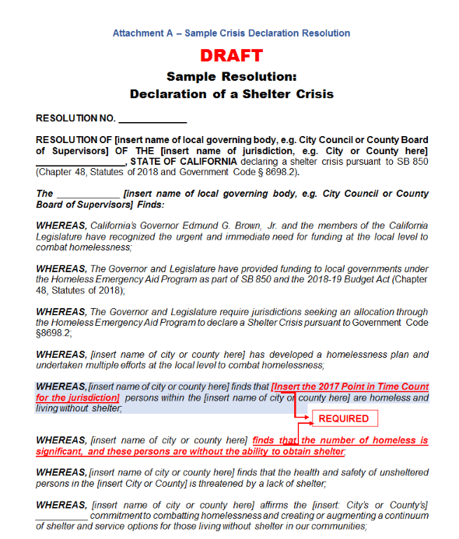
Declaration Sample

Slide 24
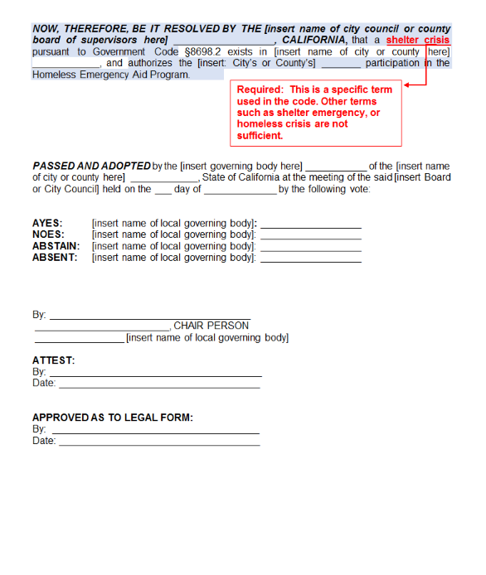
Declaration Sample (continued)

Slide 25
Eligible Uses of HEAP Funds
HEAP funds are intended to provide immediate emergency assistance to people experiencing homelessness or at imminent risk of homelessness.
The parameters of the program are intentionally broad to allow local communities to be creative and craft programs that meet the specific needs that have been identified.
Applicants will include in their proposals how the proposed activity is directly related to providing immediate emergency assistance to people experiencing homelessness or at imminent risk of homelessness.
The uses must align with California’s Housing First policy.
https://www.bcsh.ca.gov/hcfc/

Slide 26
Eligible Uses of HEAP Funds
Examples include, but are not limited to:
Services: Street outreach, health and safety education, criminal justice diversion programs, homelessness prevention activities, and other service activities.
Rental assistance or subsidies: Housing vouchers, rapid re-housing programs, flexible housing subsidy funds, and eviction prevention strategies.
Capital improvements: Emergency shelter, navigation centers, transitional housing, permanent supportive housing, small/tiny houses, and improvements to current structures that serve homeless individuals and families. Some communities are discussing solutions to address homelessness and the public health crisis by using funds for handwashing stations or public toilet and shower facilities.
Administrative costs: are allowed, but capped at five percent of program funds. This does not include staff costs directly related to carrying out program activities.
Other
https://www.bcsh.ca.gov/hcfc/

Slide 27
Homeless Youth Set Aside
At least five percent of HEAP funds must be used to establish or expand services meeting the needs of homeless youth or youth at risk of homelessness.
5 percent is the MINIMUM, there is no maximum.
The HEAP team encourages and expects local CoCs and large cities to work with youth advocates and youth service providers to determine the most appropriate services for this target population.
Consistent with other state and federal definitions, HCFC considers “homeless youth” to mean an unaccompanied homeless individual who is not older than 24, for purposes of HEAP. Homeless individuals not older than 24 who are parents are included in this definition.
https://www.bcsh.ca.gov/hcfc/

Slide 28
Ineligible Uses of HEAP Funds
Generally, if HEAP funds are used to pay for activities that serve homeless individuals or families or those at imminent risk of homelessness, the uses are allowed, with the following restrictions:
Jurisdictions that have not declared a shelter crisis may not be the direct recipient of HEAP funding.
CoCs, cities, counties, and nonprofit organizations may not use HEAP funds for capital projects, such as building or expanding a shelter or navigation center, or for rental assistance, within a jurisdiction that has not declared a shelter crisis.
HEAP funds cannot be used to fund HMIS infrastructure or improvements.
HEAP funds cannot be used to create a strategic plan for addressing homelessness.
HEAP funds cannot be expended after June 30, 2021. Any long-term projects that would require payment after that date are not appropriate uses of HEAP funds.
Expenditures not intended for the purposes of providing aid for persons who are homeless or at imminent risk of homelessness are not appropriate uses of HEAP funds.
https://www.bcsh.ca.gov/hcfc/

Slide 29
Technical Assistance
HCFC will provide ongoing technical assistance and training to support CoCs and large cities.
Housing and Community Development (HCD) and HCFC have scheduled workshops to provide information (see schedule).
HCFC will schedule additional workshops and webinars.
https://www.bcsh.ca.gov/hcfc/

Slide 30
HCD Workshop Schedule
CITY | DATE | LOCATION | TIME | Registration
Sacramento | August 24 | CA Department of Housing and Community Development Room 402 2020 W El Camino Ave, Sacramento, CA 95833 | 10:00 am-4:30 pm | In person registration Track 1: NPLH 10:00 am-4:30 pm Meeting number: 731 023 870 Meeting password: NPLH1 Join the webinar Audio Only: (877) 873-8018 Access code: 9035096 Track 2: CESH/HEAP 10:00 am-4:30 pm Software download Join the webinar Audio Only: (877) 336-1829 Access code: 2636575
Oakland | August 30 | Elihu Harris Building Room 1 1515 Clay St Oakland, CA 94612 | 10:00 am-4:30 pm | In person registration
Visalia | September 7 | Tulare County Office of Education Redwood EF 6200 S Mooney Blvd Visalia, CA 93277 | 10:00 am-4:30 pm | In person registration
Riverside | September 10 | California Tower Room 200 3737 Main St Riverside, CA 92501 | 10:00 am-4:30 pm | In person registration
https://www.bcsh.ca.gov/hcfc/

Slide 31
Contact Information
Additional information regarding the HEAP program is available on the HCFC website. https://www.bcsh.ca.gov/hcfc/
To receive information releases regarding the HEAP program, please register for the program listserv
If you have questions, please direct them to the HCFC inbox at HCFC@BCSH.ca.gov
Social media
https://twitter.com/CA_HCFC
https://www.facebook.com/CalHCFC/
https://www.bcsh.ca.gov/hcfc/

Slide 32
Contact Information
Danny Castillo, HEAP Grant Manager
916-651-2788
Daniel.Castillo@bcsh.ca.gov
Lahela Mattox, Local Government Liaison
916-651-2770
Lahela.mattox@bcsh.ca.gov
https://www.bcsh.ca.gov/hcfc/

Slide 33
QUESTIONS?
https://www.bcsh.ca.gov/hcfc/

