Slide 1



Slide 2
California Homeless Data Integration System
  Agenda Item V.
  Homeless Coordinating and Financing Council Meeting
  April 9, 2019
https://www.bcsh.ca.gov/hcfc/

Slide 3
Project Context and Background
Continuums of Care
Homeless Management Information Systems
The “As-Is” in California
Homeless Coordinating and Financing Council Statutory Goals
Project Vision
https://www.bcsh.ca.gov/hcfc/

Slide 4
Project Context and Background
I. Continuums of Care (CoCs)
Operate within a geographic area.
Coordinate housing and services for individuals experiencing homelessness.
Collect client information and input it into their local Homeless Management Information Systems.
Distribute HUD and State funding (e.g., HEAP and CESH) to housing and service providers.
44 CoCs in California.
https://www.bcsh.ca.gov/hcfc/

Slide 5
Project Context and Background
II. Homeless Management Information Systems (HMIS)
Data system used to record and analyze client, service, and housing data for individuals who are homeless or at risk of homelessness.
CoCs and service providers enter HUD-required data elements into HMIS.
Produces unduplicated estimates of the number of people experiencing homelessness.
Provides insights into the characteristics of homelessness.
Identifies patterns of service use.
Produces annual aggregate reports to HUD. Produces client-level reports to Department of Veterans Affairs.
36 implementations of HMIS in California.
https://www.bcsh.ca.gov/hcfc/

Slide 6
Project Context and Background
III. The “As-Is” in California
The state is not connected to the CoC – HUD data structure.
The Annual Homeless Assessment Report (AHAR) to Congress is the principal source of statewide data.
No state access to continuous, up-to-date data.
No ability to query data to answer key policy questions.
No data analytics and business intelligence tools to recognize patterns and predict trends.
Some CoCs lack the resources and capacity to fully utilize the data captured in HMIS for program planning and implementation.
https://www.bcsh.ca.gov/hcfc/

Slide 7
Project Context and Background
IV. Homeless Coordinating and Financing Council Statutory Goals and Requirements
“To create a statewide data system or warehouse that collects local data through Homeless Management Information Systems, with the ultimate goal of matching data on homelessness to programs impacting homeless recipients of state programs, such as Medi-Cal or CalWORKS.” Welfare and Institutions Code section 8257(b)(13).
Homeless Youth Act of 2018
  “All recipients [of state funding related to youth homelessness] shall be required to share with the council any relevant data from their Homeless Management Information Systems.” WIC § 8261(2)(B).
  “The council shall seek data from any and all relevant sources, including the Homeless Management Information System (HMIS), if available, in order to meet the requirements of this section.” WIC § 8261(2)(C).
https://www.bcsh.ca.gov/hcfc/

Slide 8
Vision for the
Homeless Data Integration System (HDIS)
Data system that links and integrates all relevant homelessness data from CoCs and other databases at the state and local level.
Comprehensive database that can be queried, recognize patterns, and features predictive capabilities.
Ability to “tell the story” – dashboard reports, data visualizations, and geospatial capabilities.
Tool for the Council, CoCs, state & local entities to measure program effectiveness and formulate data-driven policy.
Other potential benefits: promote cooperation between and among state and local partners, better align resources with needs; reduce CoC’s administrative costs for HMIS so they can focus on coordination, analytics, and service delivery.
https://www.bcsh.ca.gov/hcfc/

Slide 9
Project Roadmap
Exploring an IT solution.
Iterative approach to design, development, and implementation.
  Breaks down project into smaller components.
  Achieves baseline data quickly.
  Flexible approach – can adapt to new information and changes in legislation or technology.
  Phase I: HMIS data.
  Phase II: State program data and local data that resides outside of HMIS.
https://www.bcsh.ca.gov/hcfc/

Slide 10
Project Roadmap
Phase I
HMIS data that conforms to HUD data standards.
Quickest path to compile a comprehensive baseline data set.
Proposed solution will include full HMIS functionality. CoCs will be able to opt into the state-level HMIS to enter data directly into the system.
https://www.bcsh.ca.gov/hcfc/

Slide 11
Project Roadmap
Phase I – Market Research
Request for Information (RFI) in Fall 2018.
13 responses received.
Theme #1: Use an out-of-the-box HMIS Solution.
Theme #2: Multiple software tools configured and integrated by one vendor to develop the centralized database with HMIS functionality.
Opportunity to develop a system that anticipates future analytic and predictive needs rather than replicate existing technology.
Collaboration with the California Department of Technology to analyze alternatives.
https://www.bcsh.ca.gov/hcfc/

Slide 12
Project Roadmap
Phase I – Stakeholder Participation
HMIS Working Group.
  Representation from 16 CoCs.
  Representation from state partners.
  Council members Ali Sutton and Emilio Ramirez.
  Meets twice monthly since December 2018.
HMIS End User Interviews.
  Humboldt, Sacramento, San Joaquin, Santa Clara, Tehama, Ventura.
HMIS Surveys.
  CoC Administrator and Program Manager Survey.
  Direct Service Provider Survey.
https://www.bcsh.ca.gov/hcfc/

Slide 13
Project Roadmap
Phase I – Stakeholder Feedback
Provide funding to offset the costs of user licenses, training, and data migration to the state-sponsored HMIS.
Improved case management.
Robust data analytics.
Modern system that uses best practices in design.
  User interface.
  Other quality-of-life improvements.
Data security and privacy issues.
https://www.bcsh.ca.gov/hcfc/

Slide 14
Project Roadmap
Phase I – Data Security and Privacy
Data security and privacy - #1 issue.
Retained the services of a Data Security and Privacy Consulting Firm – Anvaya Solutions.
Received advice from Agency’s legal counsel, Information Security Officer, and Chief Privacy Officer.
Developing data security and privacy requirements in line with best practices and relevant authorities.
  State Administrative Manual.
  National Institute of Standards and Technology.
  State and federal privacy laws as applicable.
https://www.bcsh.ca.gov/hcfc/

Slide 15
Road Map – Phase II
State data (e.g., Medi-Cal, CalWORKS).
Local data that resides outside of HMIS (e.g., county mental health, county jail system). Each CoC has various levels of participation and integration.
Prioritize datasets.
  Will prioritize in partnership with state and local partners.
  Prioritize based on criticality and readiness.
Expand to unstructured data (e.g., scanned documents, web pages).
Iterative approach – includes ongoing assessment of data security and privacy.
https://www.bcsh.ca.gov/hcfc/

Slide 16
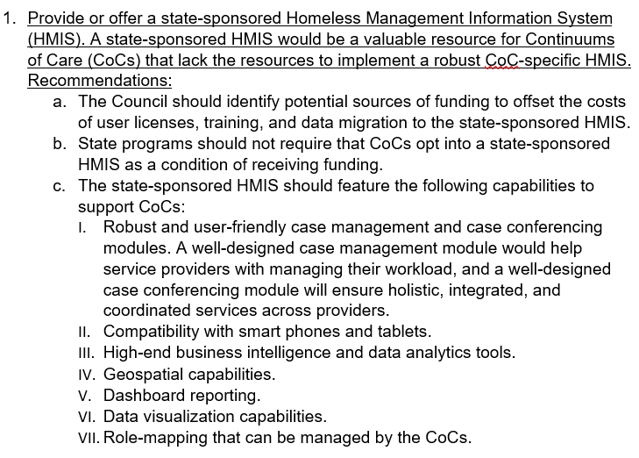
HMIS Working Group Recommendations
https://www.bcsh.ca.gov/hcfc/

Slide 17
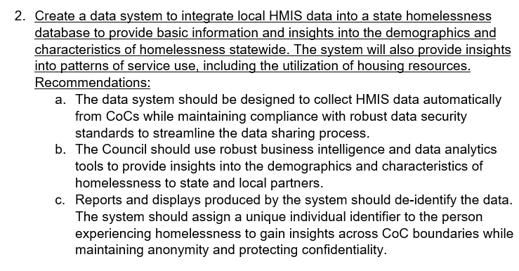
HMIS Working Group Recommendations
Continued
https://www.bcsh.ca.gov/hcfc/

Slide 18
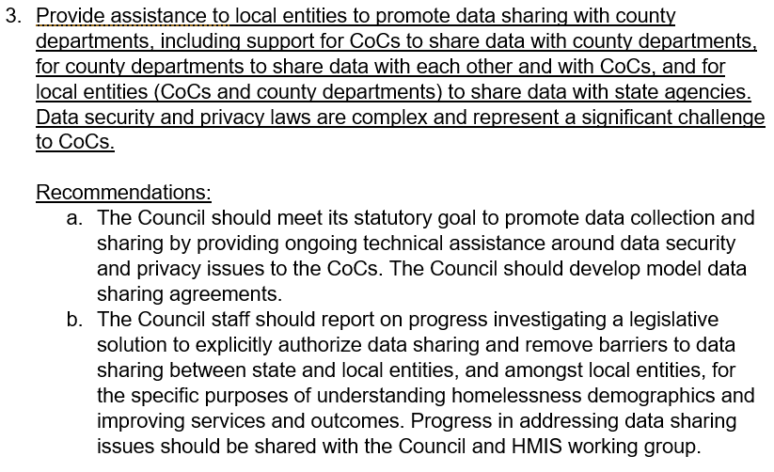
HMIS Working Group Recommendations
Continued
https://www.bcsh.ca.gov/hcfc/

Slide 19
Questions?
https://www.bcsh.ca.gov/hcfc/

Slide 20
Resources
Background information and FAQ: https://www.bcsh.ca.gov/hcfc/documents/hmis_exploring.pdf
Project proposal tracking – Project 0515-001: https://cdt.ca.gov/pal-it-project-proposal-tracking/
Contact Information:
KC Mohseni
Project Manager
916.201.2037
KC.Mohseni@bcsh.ca.gov
https://www.bcsh.ca.gov/hcfc/

