Slide 1
Homeless Point-in-Time Count
Ben Avey, Sacramento Steps Forward
Arturo Baiocchi, MA, PhD, Sacramento State, Institute for Social Research

Slide 2
Sacramento Steps Forward is a non-profit 501(c)(3) organization that’s working to end homelessness in our region through collaboration, innovation, and connection to services.

Slide 3
Our Work
Continuum of Care Administrator
CoC Contract Management
Coordinated Entry System Administrator
HMIS Administrator
Point-in-Time Count
Homeless Street Case Management
Training and Education
Data Analytics and Research
Community Engagement and Leadership

Slide 4
Point-in-Time Count
What it is and why it is important (10 minutes)
How it is conducted (5 minutes)
Discussion (15 minutes)

Slide 5
What
A census of individuals/households experiencing HUD defined homelessness within the Continuum of Care during a 24-hour period.
is the Point-in-Time Count

Slide 6
“…nighttime residence not designed for or ordinarily used as a regular sleeping accommodation for human beings, including a car, park, abandoned building, bus or train station, airport, or camping ground.”
(24 CFR 578.3)

Slide 7
Required
Sheltered and unsheltered count is required to be conducted every 2 years.
Sheltered count conducted annually, but not as informative.
Conducted during last 10 days of January nation-wide.

Slide 8
Snapshot

Slide 9
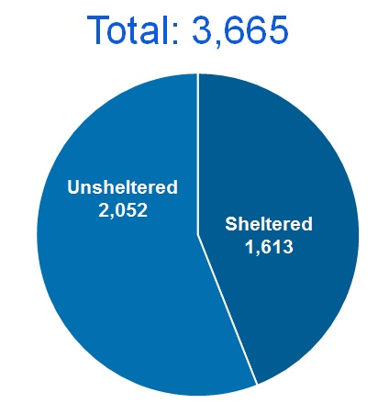
2017 Point in Time Count

Slide 10
3,897
Newly Housed in 2017

Slide 11
7,370
Newly Homeless in 2017

Slide 13
Value
Provides data over time – trends
Provides opportunity for survey collection
Community engagement and education

Slide 14
Caveats
The PIT is likely an undercount
Subpopulations are hard to count – families and youth
External factors like weather can influence count
Methodology should improve over time which can increase count
Its not cheap

Slide 15
How
Volunteer teams deploy to designated geographic locations to count people and conduct surveys.
is the count conducted?

Slide 16
In Sacramento
Jan. 30-31
800 volunteers
4 person teams with electronic survey tool
Designated count/survey area with route map
People, structures, cars, and tents

Slide 17
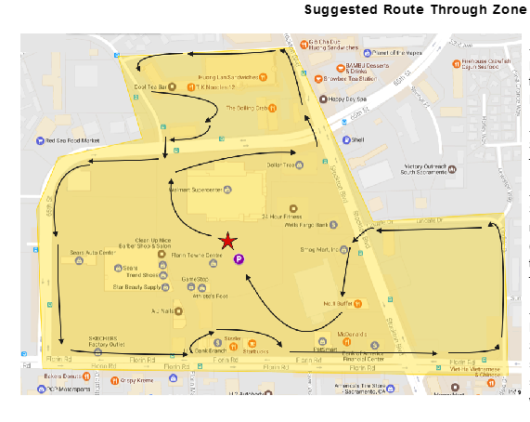

Slide 18
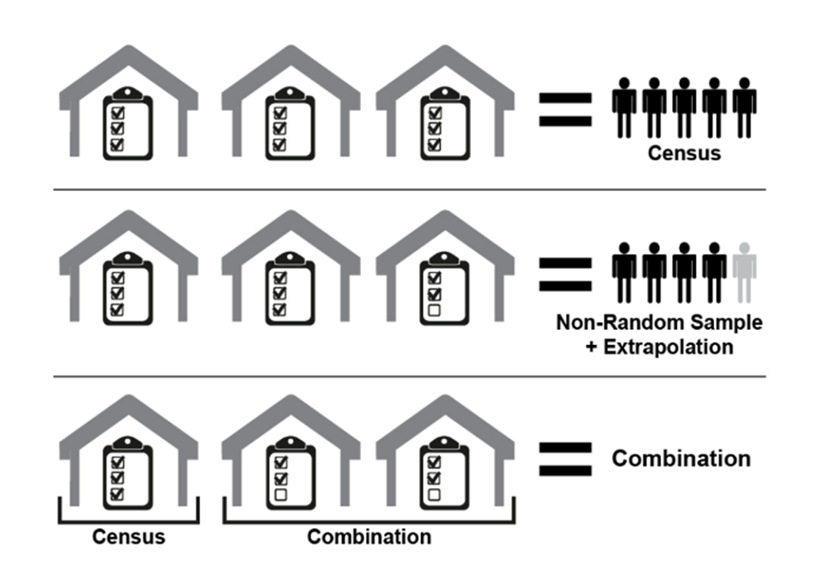

Slide 19
New in 2019
Electronic cloud based count and survey tool (smart phone)
Standardizing sampling units (mapping areas) (approx. .252 miles)
Experiment with Census Block Groups (Sacramento only)
Prepare for a 2-night count to maximize volunteer resources
Testing new methodology while retaining certainty of traditional counts.

Slide 20
Post Count
Clean & de-duplicate data
Extrapolate demographic composition: survey +count
Combine with sheltered data
General and statistical analysis
Full report published in June 2019

Slide 21
Our Team
Division of Social Work
Arturo Baiocchi, MA PhD
Susanna Curry, MSW PhD
Ethan Evans, MSW PhD
Sampling Consultant
Justin Morris, MA
Public Health Survey Research
Institute for Social Research
Shannon Williams, PhD
Valory Messier, MA
Jessica Newhman
Graduate Student Researchers
Nathan Garst
Alicia Hatfield
Fleur Marfori
Sacramento Steps Forward
Michele Watts
Nick Lee, MBA
Ben Avey
Chris Weare, PhD
Lindsey Moss
Matt Lee
Tina Wilton
Peter Hoy

Slide 22
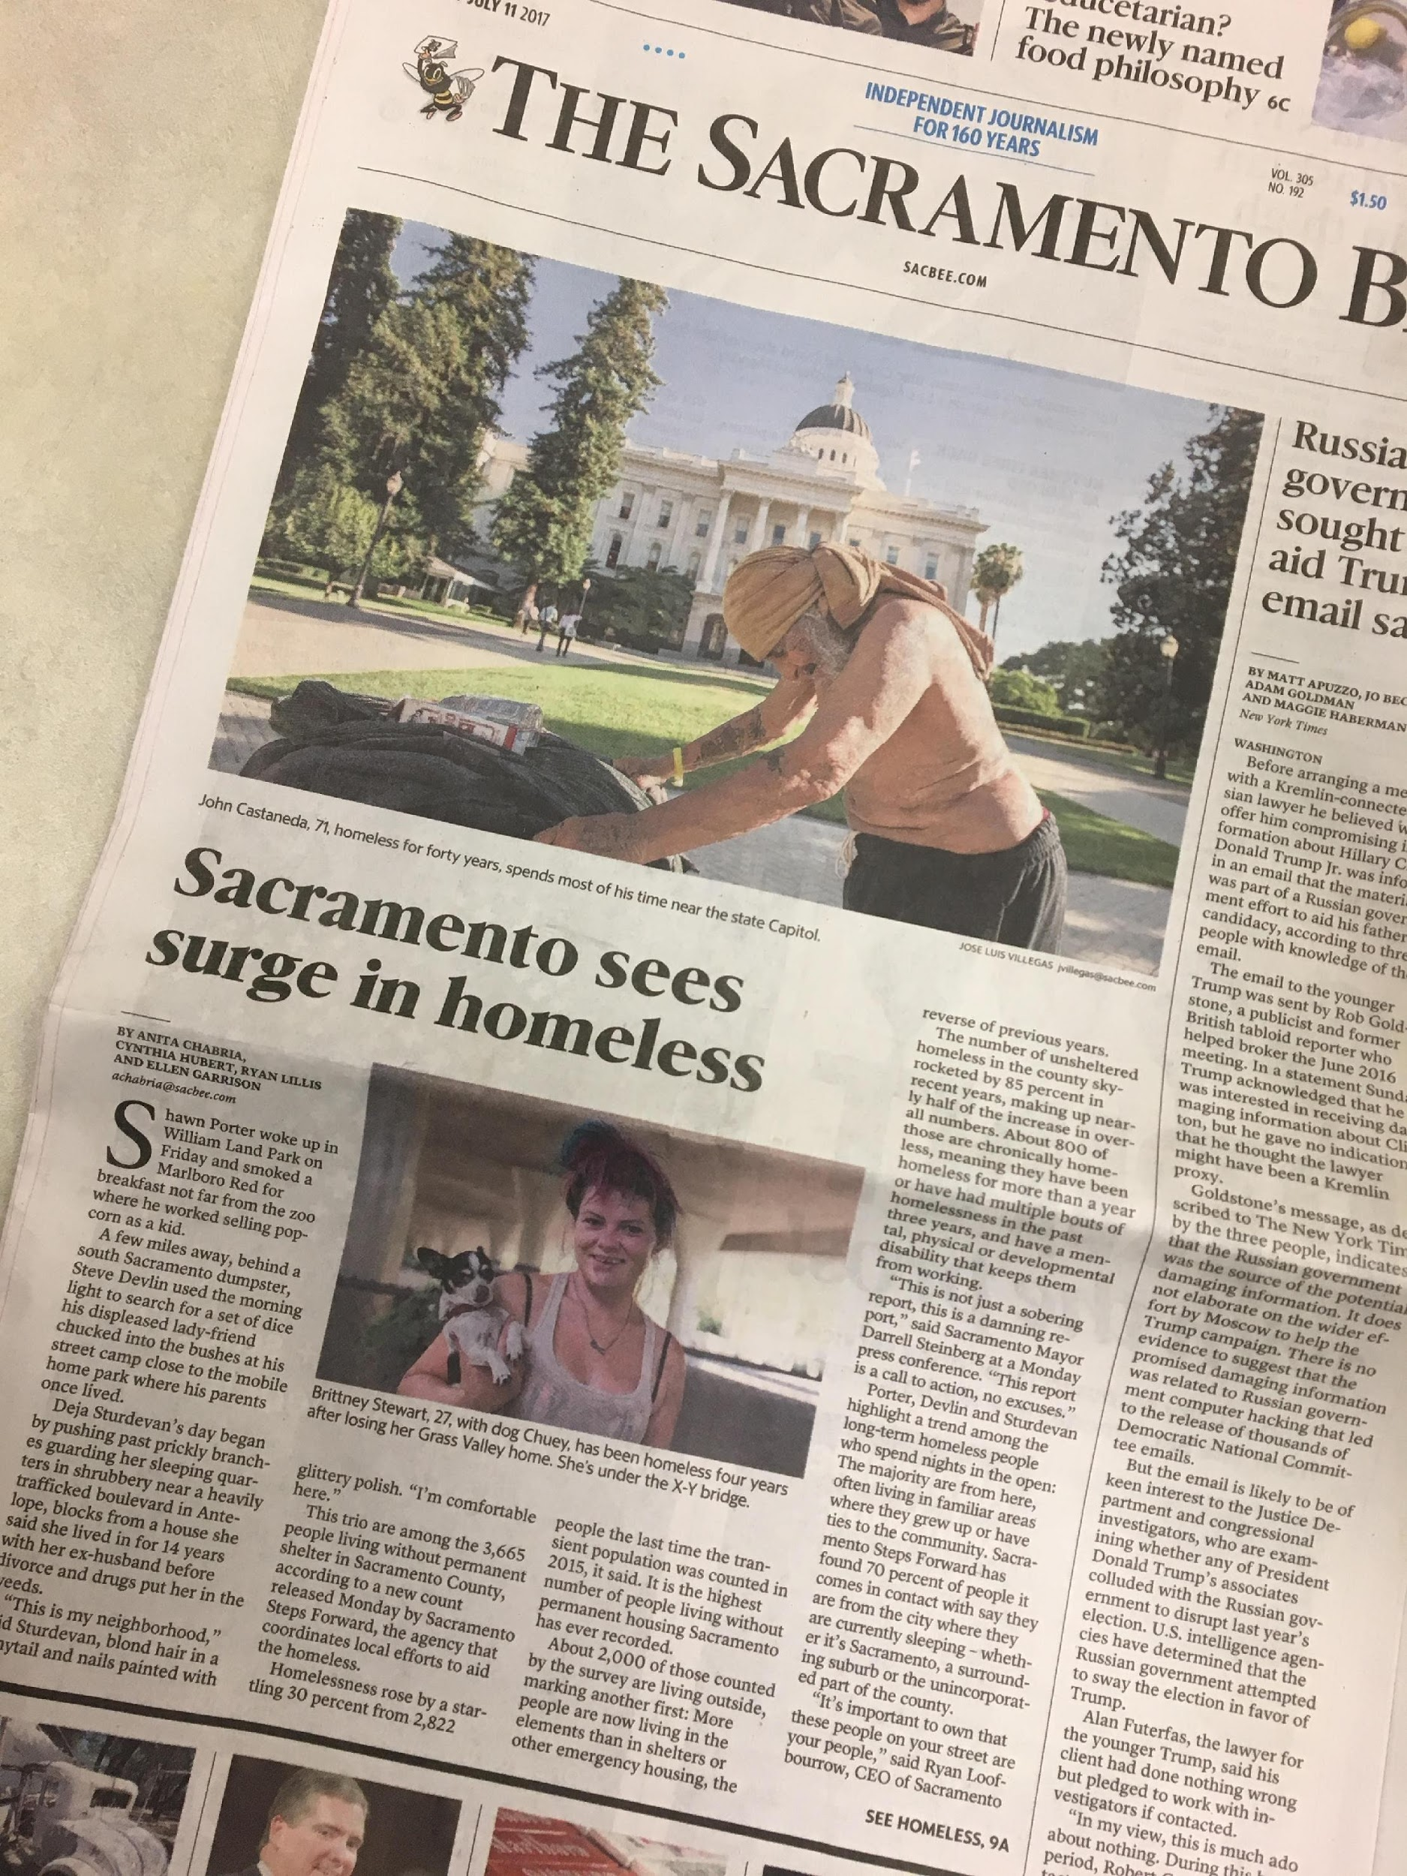
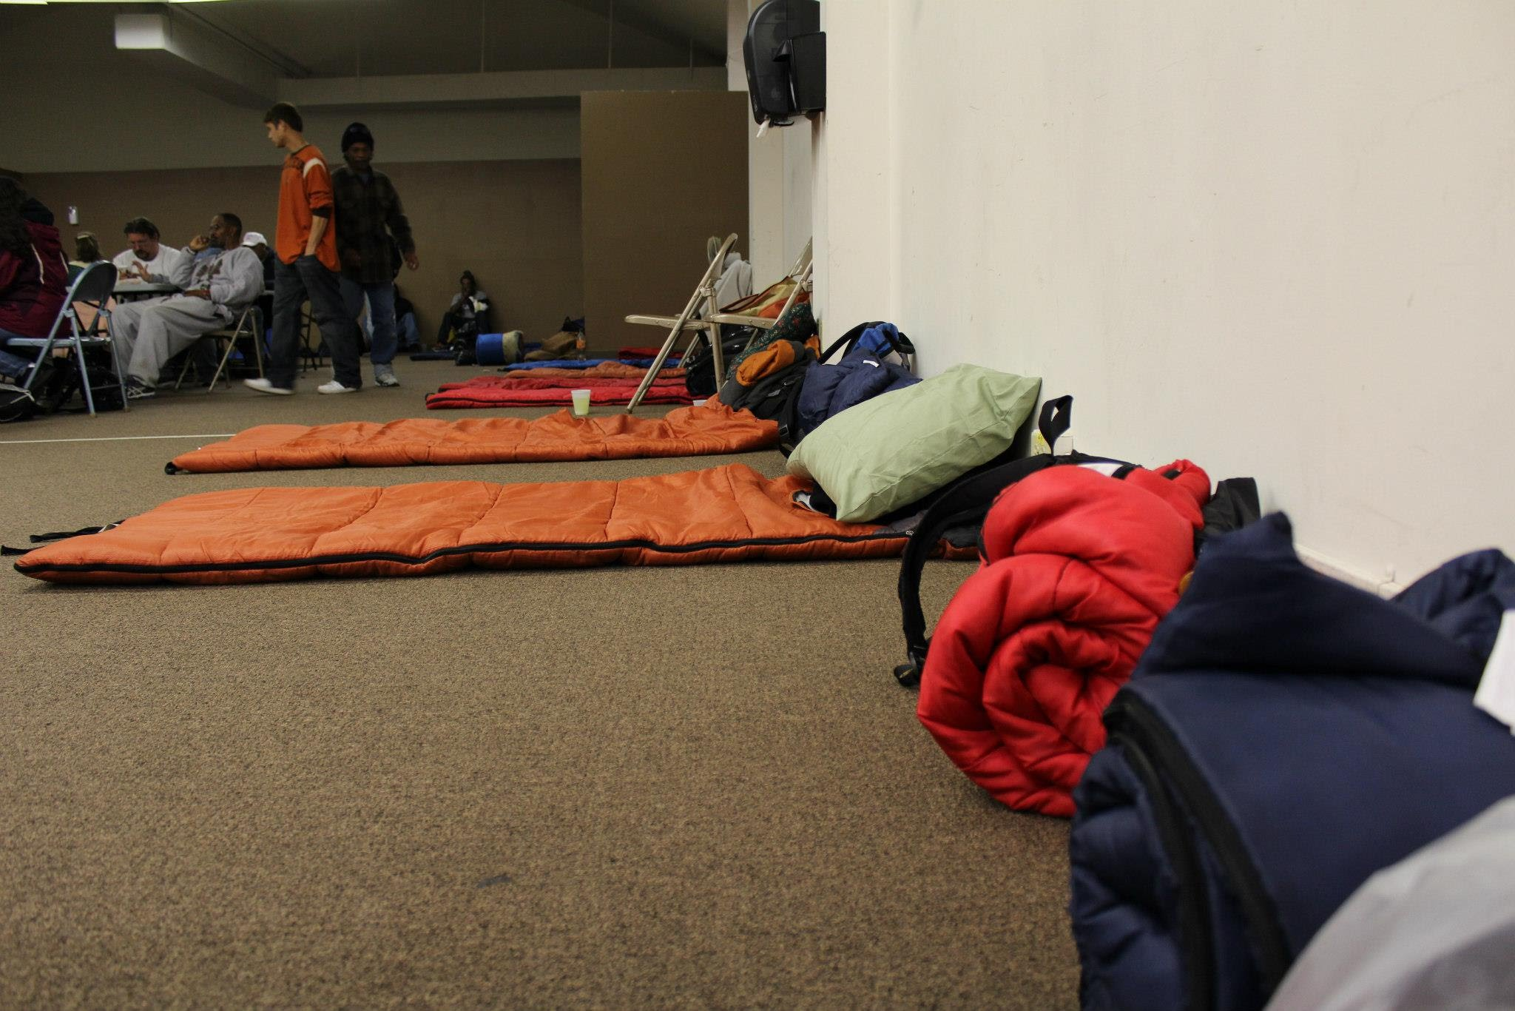
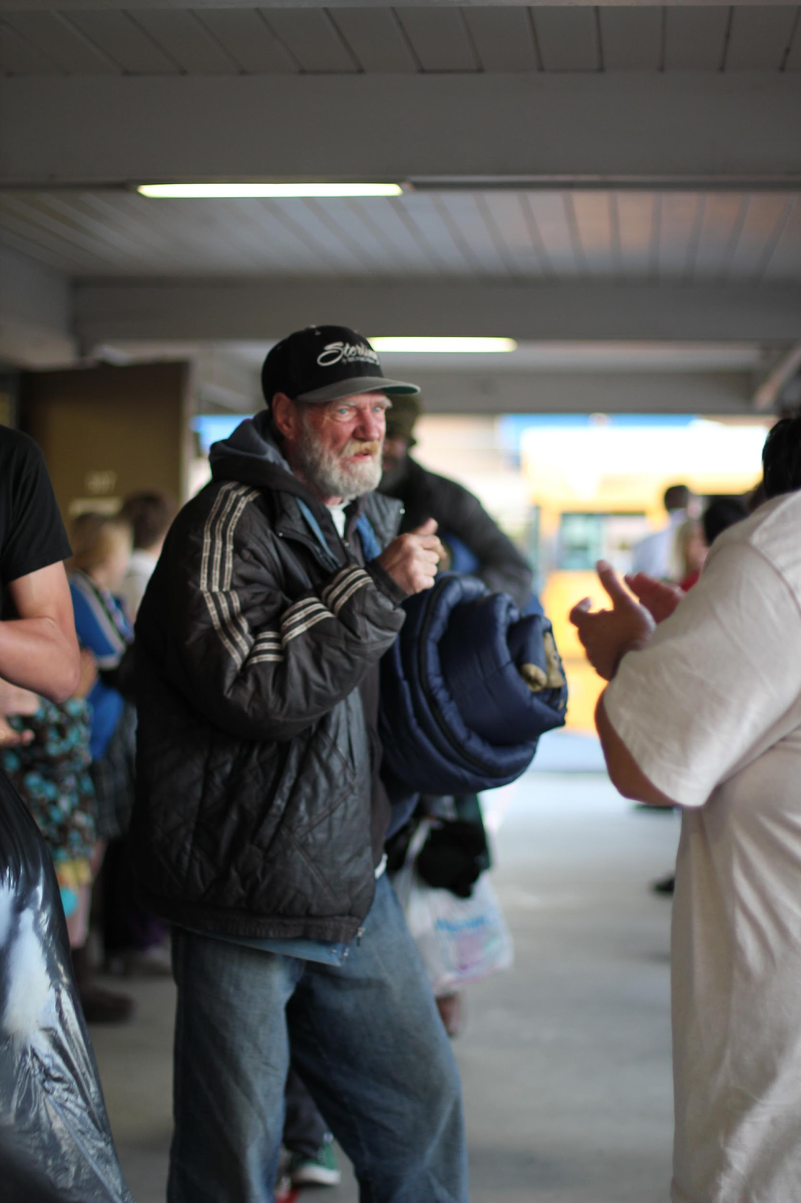
Questions?

