Slide 1
Homeless Emergency Aid Program
July 11, 2018

Slide 2
Homeless Emergency Aid Program
$500 million to local governments
One-time flexible block grants
Intended to address immediate homeless challenges

Slide 3
HEAP Distribution
$250M
Continuum of Care
PIT Ranges
$100M
Continuum of Care
% of homeless population
$150M
City / City that is also a County
Population > 330,000

Slide 4
HEAP Eligibility Criteria
Declaration of shelter crisis before award
For COC allocations, demonstrate coordination between receiving cities/counties

Slide 5
HEAP Draft Timeline
Statutory Requirements:
Applications for 1st round submitted NLT 12/31/2018
Round 1 funds disbursed NLT 1/31/2019
Applications for 2nd round submitted NLT 4/30/2019
Round 2 funds disbursed NLT 5/31/2019
Round 3 TBD
Grant Management Goals:
Applications available as possible
Applications / Disbursements made on a rolling basis
Funds disbursed as quickly as possible

Slide 6
HEAP Draft Timeline
Round 1 | Onboard Staff
 | NOFA Open
 | App Review
 | Notification of Awd
 | Contract Executed
 | Disburse Payment
Round 2 | NOFA Open
 | App Review
 | Notification of Awd
 | Contract Executed
 | Disburse Payment
July | Aug |  | Spt |  | Oct |  | Nov |  | Dec | Jan |  | Feb | Mar | Apr | May | Jun
Note: 50% obligated by 1/1/20; 100% obligated by 6/30/21 →

Slide 7

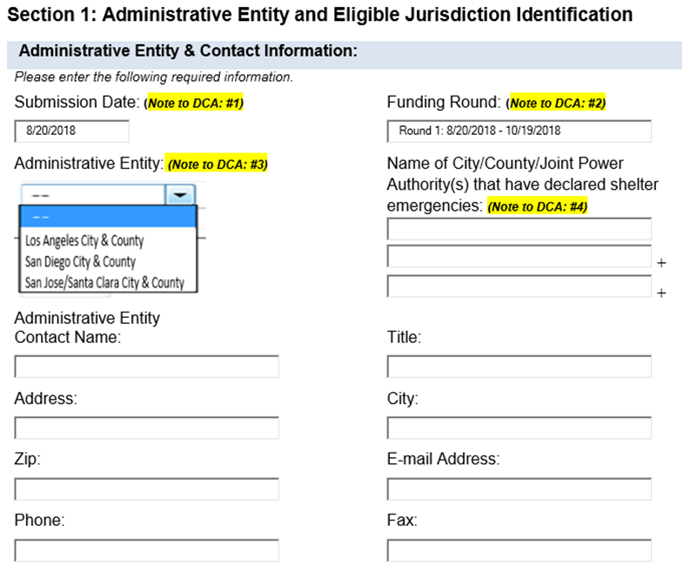
HEAP Application
Online collection form
Automated when possible
Drop-down menus to ensure data integrity
Identical information between two applications
  Continuums of Care
  Cities

Slide 8
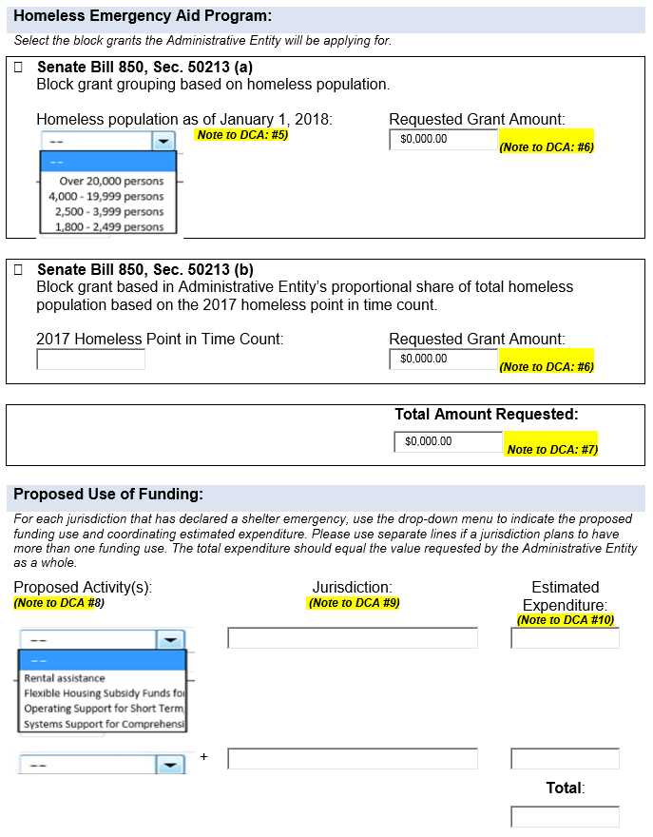
HEAP Application
Option to apply for one, two, or three blocks of funding
Designate proposed activity by jurisdiction to ensure shelter crisis criteria met
Expenditure planning will support reporting requirements

Slide 9
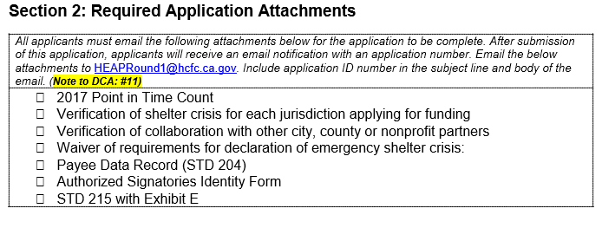
HEAP Application
Submit application to receive Applicant ID #
Email eligible criteria documents to HCFC
Front-load payee forms to reduce processing time
Available prior to NOFA to encourage / support early applicants

